Slide 1
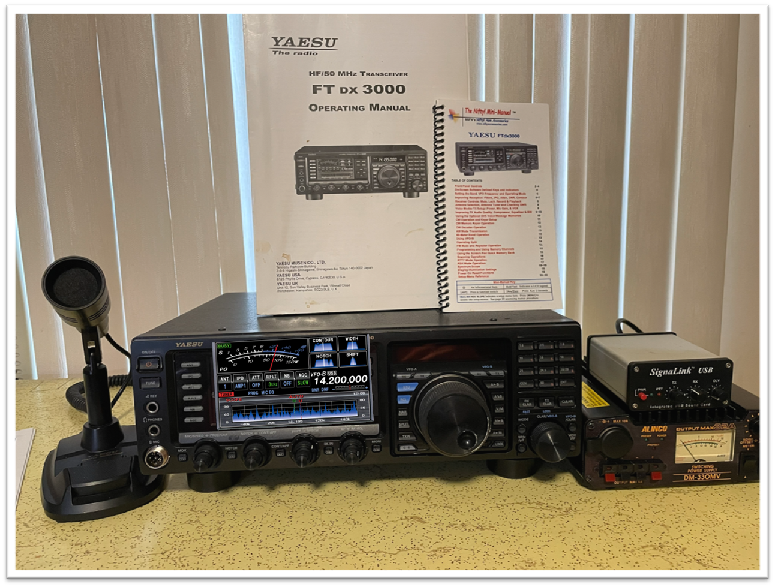

Yaesu FT DX-3000
A high-performance all-mode amateur HF/50 MHz base transceiver designed for serious ham radio operators.
Bands: 160 m through 6M.
General-coverage 30 kHz to 56 MHz.
SSB, CW, AM, FM, RTTY, and other digital modes.
Double-conversion superheterodyne receiver with hi-performance crystal roofing filters.
32-bit IF DSP to deliver strong signal handling and low noise.
Built-in automatic antenna tuner.
High-speed spectrum scope with a color TFT display.
Adjustable RF output up to 100 W.
USB/CAT computer control,
Multiple antenna connectors and memory
💰 Typical Used Prices
📻 Yaesu FT DX-3000
Many pre-owned units are listed around ~$850 – $1,000 “Buy It Now” prices on eBay.
Community reports and reviews also note that used FT-DX3000s generally sell for “right around a kilo-buck (~$1,000).”
Some listings and private sales show used units fetching $1,000 – $1,150 depending on condition and included accessories.
Contact: Mike WD8S at wd8s@arrl.net

Slide 2
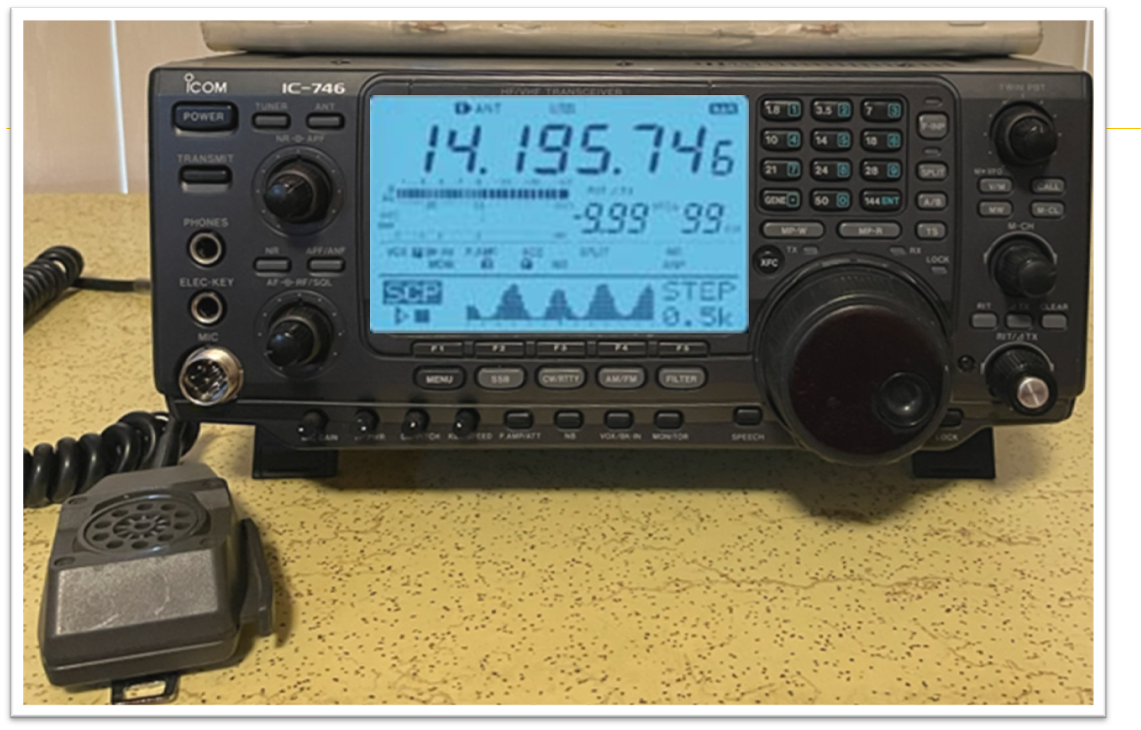
Icom IC-746
A versatile all-mode amateur radio transceiver
Base station rig for HF, 6 m, and 2 m.
Covers 160 m through 10 m includes 50 MHz and 144 MHz bands,
SSB, CW, AM, FM, RTTY, and other digital modes.
100 W of output power
General communications, DX, and local VHF contacts.
Features built-in DSP functions that provide noise reduction,
Automatic notch filtering and selectable audio passband.
Filtering to improve receive clarity.
Automatic antenna tuner.
Spectrum scope.
Memory channels with alphanumeric tagging.
RIT/XIT, Noise blanking, VOX.
Multi-function LCD display.
💰 Typical Used Prices
📻 Icom IC-746 (Standard / Non-Pro)
Typical working used units with power supply and mic are commonly listed around $300 – $600 USD on eBay and similar marketplaces. Many show prices in that range for clean, tested radios.
Some higher listings — often including extras or “open box / hardly used” condition — appear up toward $700 – $750 USD.
Lower-end or “for repair/parts” listings can be under $300 but aren’t representative of fully working rigs.
Contact: Mike WD8S at wd8s@arrl.net

Slide 3
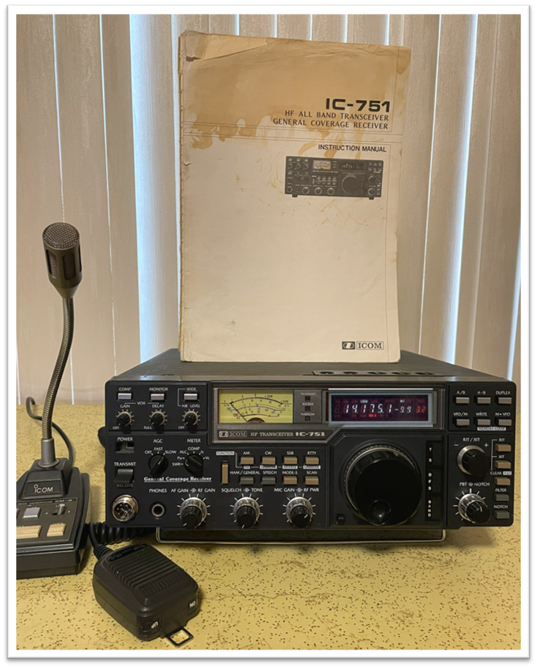
Icom IC-751
A classic all-mode HF amateur radio transceiver.
HF amateur bands from 160 m through 10 m
10 W up to 100 W
SSB/CW/RTTY modes and somewhat lower power in AM,
General-coverage receiver 0.1 MHz up to 30 MHz
Dual digital VFOs
Analog S/RF meter,
Built-in noise blanker
Notch filtering.
Passband tuning,
RIT/XIT for fine receive/transmit offset adjustments.
Preamp/attenuator.
32 memory channels
Solid-state design.
All modes including SSB, CW, AM, FM, and RTTY.
💰 Typical Used Prices
📻 Icom IC-746 (Standard / Non-Pro)
Icom IC‑751 HF Transceiver No Microphone — ~$365 USD (working transceiver, no mic included)
Icom IC‑751A HF Transceiver with AT100 Antenna Tuner — ~$525 USD (used unit with antenna tuner)
Vintage Icom IC‑751 HF Transceiver No Power Supply — ~$300 USD (untested/parts)
Icom Ic‑751 All‑mode HF Ham Radio Transceiver For Parts Or R — ~$399.97 USD (parts/repair listing)
Contact: Mike WD8S at wd8s@arrl.net

Slide 4
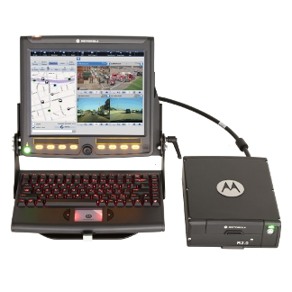
Motorola MW-810 Mobile Workstation
A ruggedized in-vehicle computing platform designed for public-safety, utility, and fleet operations where real-time data and communications are critical.
Built around a hardened Windows-based computer, it integrates GPS, wireless data modems, multiple serial and Ethernet interfaces, and Motorola radio control into a single dashboard-mounted unit.
Allows police officers, firefighters, and field crews to access CAD dispatch systems, mapping, vehicle location, messaging, and database queries while on the move.
The MW-810 connects directly to Motorola mobile radios, enabling screen-based channel control, status messaging, and emergency signaling, while its touchscreen display and programmable buttons provide fast, glove-friendly operation in high-stress environments.
Designed to withstand vibration, heat, cold, and electrical noise found in vehicles, the MW-810 became a core building block of early mobile data terminals (MDTs) and modern public-safety fleet communications systems.
Contact: Andrew at ajohns1288@gmail.com

